Slide 1
Vectorization in NLP
Lec # 2
By Talha Ahmed

Slide 2
METHODS
One-Hot Encoding
Bag Of Words (BOW)
TF-IDF
Word Embeddings

Slide 3
One Hot Encoding
Definition: One-Hot Encoding is a technique used to represent words as vectors. Each word in the vocabulary is converted into a binary vector with a length equal to the size of the vocabulary.
Key Point: Each word is represented by a vector with all zeros except for a single 1 corresponding to the word's index in the vocabulary.

Slide 4
Example Texts
Text 1: "I love natural language processing."
Text 2: "Natural language processing is fascinating."
Text 3: "I love programming and data science."

Slide 5
Steps to Create One-Hot Encoding
Step 1: Tokenize the text into words.
Step 2: Create a vocabulary of unique words.
Step 3: Assign a binary vector to each word where only the position corresponding to the word is 1, and all others are 0.

Slide 6
Vocabulary
{'i', 'love', 'natural', 'language', 'processing', 'is', 'fascinating', 'programming', 'and', 'data', 'science'}

Slide 7
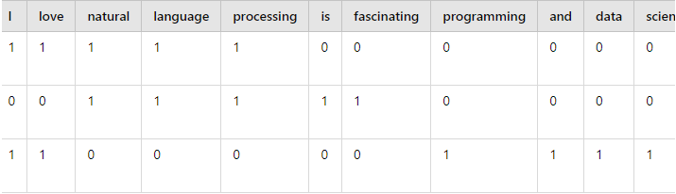
One-Hot Encoding Matrix

Slide 8
ADVANTAGES
Simplicity and Ease of Implementation: Straightforward to implement and understand.
No Assumptions About Relationships: Treats all categories as distinct, with no implied relationships.
Compatibility with Simple Models: Works well with basic machine learning models like logistic regression.
No Ordinality Issues: Avoids implying a false order or ranking between categories.
Interpretability: Vectors are easy to interpret, with each position corresponding to a specific word or category.
Effective for Small Vocabulary Sizes: Efficient for datasets with a small number of unique words.

Slide 9
ADVANTAGES
Simplicity and Ease of Implementation: Straightforward to implement and understand.
No Assumptions About Relationships: Treats all categories as distinct, with no implied relationships.
Compatibility with Simple Models: Works well with basic machine learning models like logistic regression.
No Ordinality Issues: Avoids implying a false order or ranking between categories.
Interpretability: Vectors are easy to interpret, with each position corresponding to a specific word or category.
Effective for Small Vocabulary Sizes: Efficient for datasets with a small number of unique words.
.

Slide 10
Disadvantages
.
High Dimensionality: Leads to large, sparse vectors, especially with a large vocabulary.
Lack of Context: Fails to capture the relationship or meaning between words.
No Frequency Information: Only indicates word presence, ignoring how often words appear.
Not Scalable: Becomes impractical with a growing vocabulary size.
No Semantic Meaning: Treats all words as equally distinct, missing similarities between them.
Poor Performance: Often results in suboptimal outcomes in complex NLP tasks.
Inefficient Memory Usage: Consumes unnecessary memory due to sparse vectors filled with zeros
.

Slide 11
Bag of Words (BoW)
Bag of Words is a simple and commonly used technique in NLP that converts text into a matrix of token counts, ignoring the grammar and word order but capturing the frequency of each word In the document.
EXAMPLE :
Text 1 : I love natural language processing.
Text 2 : Natural language processing is fascinating.
Text 3 : I love programming and data science.

Slide 12
Steps to Create a BoW Model:
Step 1: Tokenize each document.
Step 2: Create a vocabulary of all unique words across the documents
Step 3: Count the occurrence of each word in each document.

Slide 13
Vocabulary
{'i', 'love', 'natural', 'language', 'processing', 'is', 'fascinating', 'programming', 'and', 'data', 'science'}

Slide 14
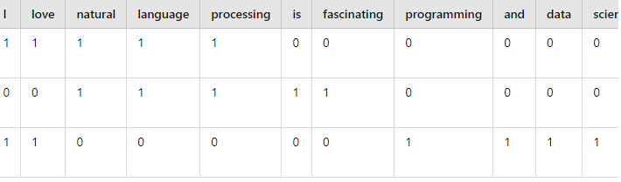
Frequency Of Unique words (Vocabulory)

Slide 15
Advantages
Simplicity: BoW is straightforward and easy to implement, making it a good starting point for text classification tasks.
Independence from Text Length: It treats each document as a collection of words without considering the order or structure, which simplifies the process.
Feature Extraction: Converts text data into numerical features that can be used by machine learning algorithms.
Scalability: Works well with large datasets and can be efficiently computed with sparse matrices.

Slide 16
Disadvantages
Loss of Context: BoW ignores the order and structure of words, which means it cannot capture the context or meaning of the text.
High Dimensionality: The feature space can become very large, especially with a large vocabulary, leading to high computational costs and potential overfitting.
Sparsity: The resulting feature vectors are often sparse, which can lead to inefficiencies in storage and processing.
No Semantic Understanding: It does not capture semantic relationships between words, so it may struggle with tasks that require understanding synonyms or polysemy.

Slide 17
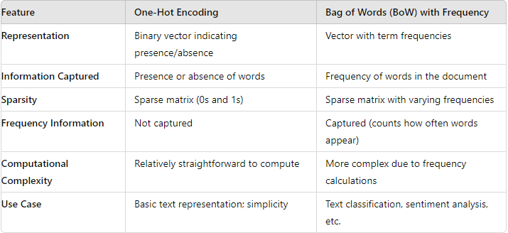
COMPARISION

Slide 18
Summary
One-Hot Encoding is simpler and focuses on the presence of words, which makes it easy to implement but lacks detail about word frequency.
Bag of Words with Frequency provides more detailed information about the text by capturing how often each word appears, which can be crucial for many NLP tasks.

Slide 19
LETZ HAVE SOME CODE
https://www.kaggle.com/code/talhaahmed9090/vectorization-in-nlp

